Slide 1

The Haunted States of America
TEAM 2
Cintia Mercado
Cristobal Bugeda
Eduardo Garza
Luis Fernando Cavazos

Slide 2


Our Vision
Decided to work on a project related to Halloween
Wouldn’t it be cool to have a site where you could find haunted places?
Name
Location
Story
Place type (house, cemetery, asylum, etc.)
Where are most haunted places located?
By State
Found a database with nearly 11,000 haunted places across the United Sates
Trans-Allegheny Lunatic Asylum, Weston, West Virginia
Haunting: Closed in 1997. In the Civil War Wing you can hear police sirens even though there are no cops in the building.
1

Slide 3
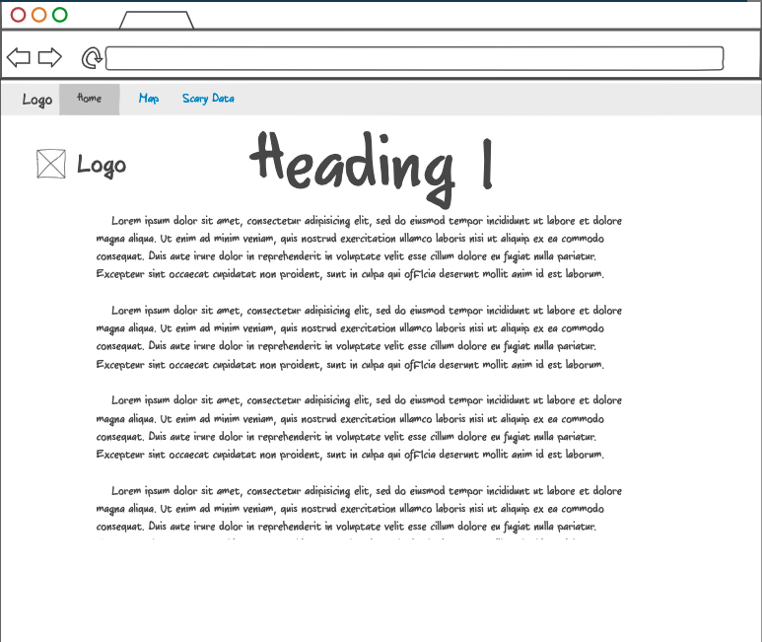
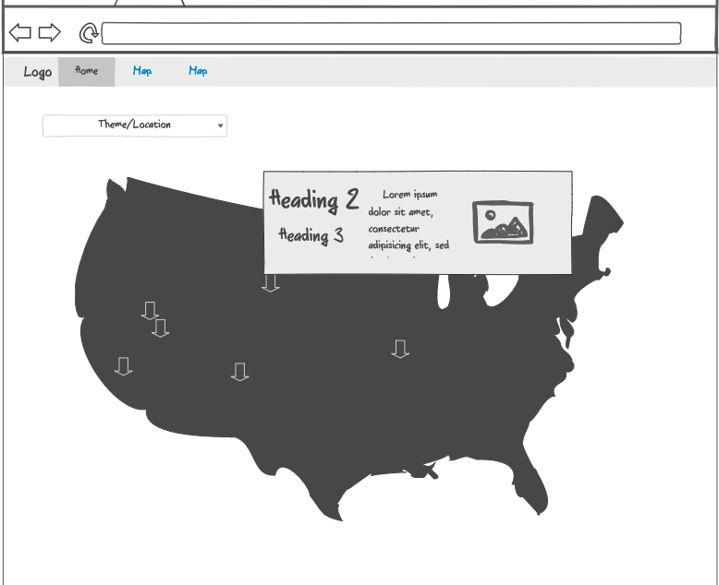
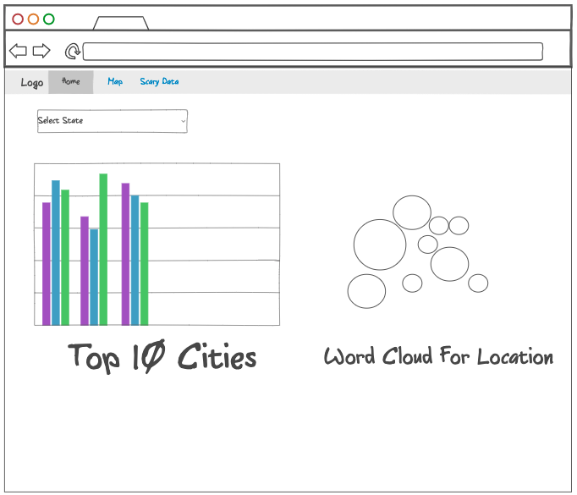
Mockups
HUANTED HOME
CURSED MAP
SPOOKY DATA
Welcome page with information about the site and inviting users to explore for more information regarding haunted places in the United States
Map displays haunted places across the United Sates
By clicking on each marker, information regarding the place’s name, type and description is displayed
Top 10 Cities based on selected State
Top 10 Place Types based on selected State
World Cloud based on place’s description (optional)
2

Slide 4



ETL
1
2
3
Downloaded csv file (“haunted_places.csv”)
Extract data (10,992 records)
Data cleansing:
Missing city, longitude or latitude
Re-order columns
Re-set index
9,720 total records exported to cleaned csv file (haunted_locations.csv”)
Generated Database in Heroku
Created Table: Locations
Schema for Locations table:
loc_id as Primary Key
Location (place´s name)
City
State
State abbreviation
Country
Longitude
Latitude
City Longitude
City Latitude
Imported csv file to table
3

Slide 5





Architecture
app.py
FRONT END
HTML
Procfile
home.html
map.html
data.html
Requirement.txt
Templates
“MIDDLEWARE”
home.html
JSON
map.html
data.html
BACK END
Static
css
app.py
JavaScript
style.css
api/locations*
api/<state>*
Render_templates:
/home
/map
/data
map.js
data.js
js
PostgreSQL
config.js
map.js
data.js
PostgreSQL
*https://haunted-america.herokuapp.com/api/locations
*https://haunted-america.herokuapp.com/api/California
4

Slide 6
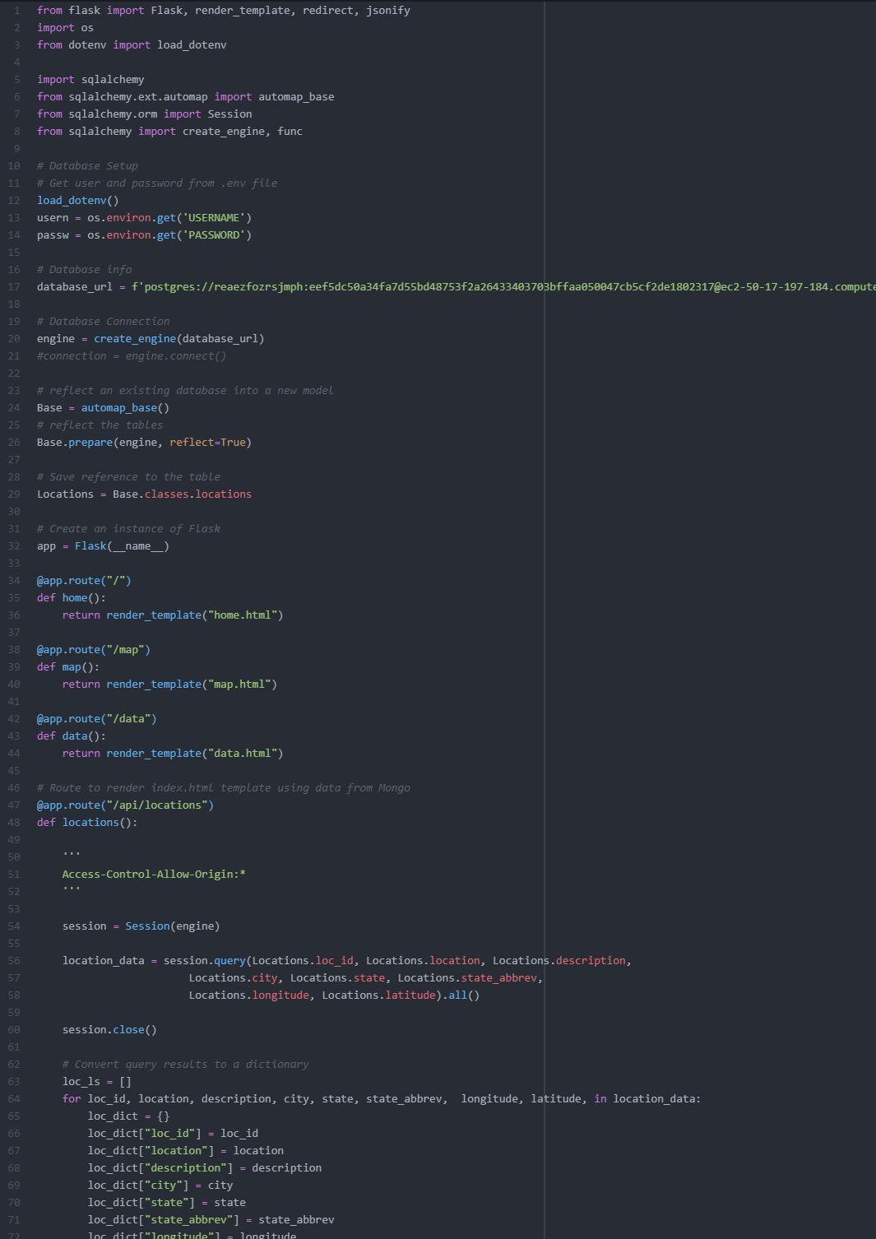
Coding > app.py
Connection to PosgreSQL
Rendered HTML Templates
Created routes:
api/locations
api/<state>
Created lists and jsonified
5

Slide 7
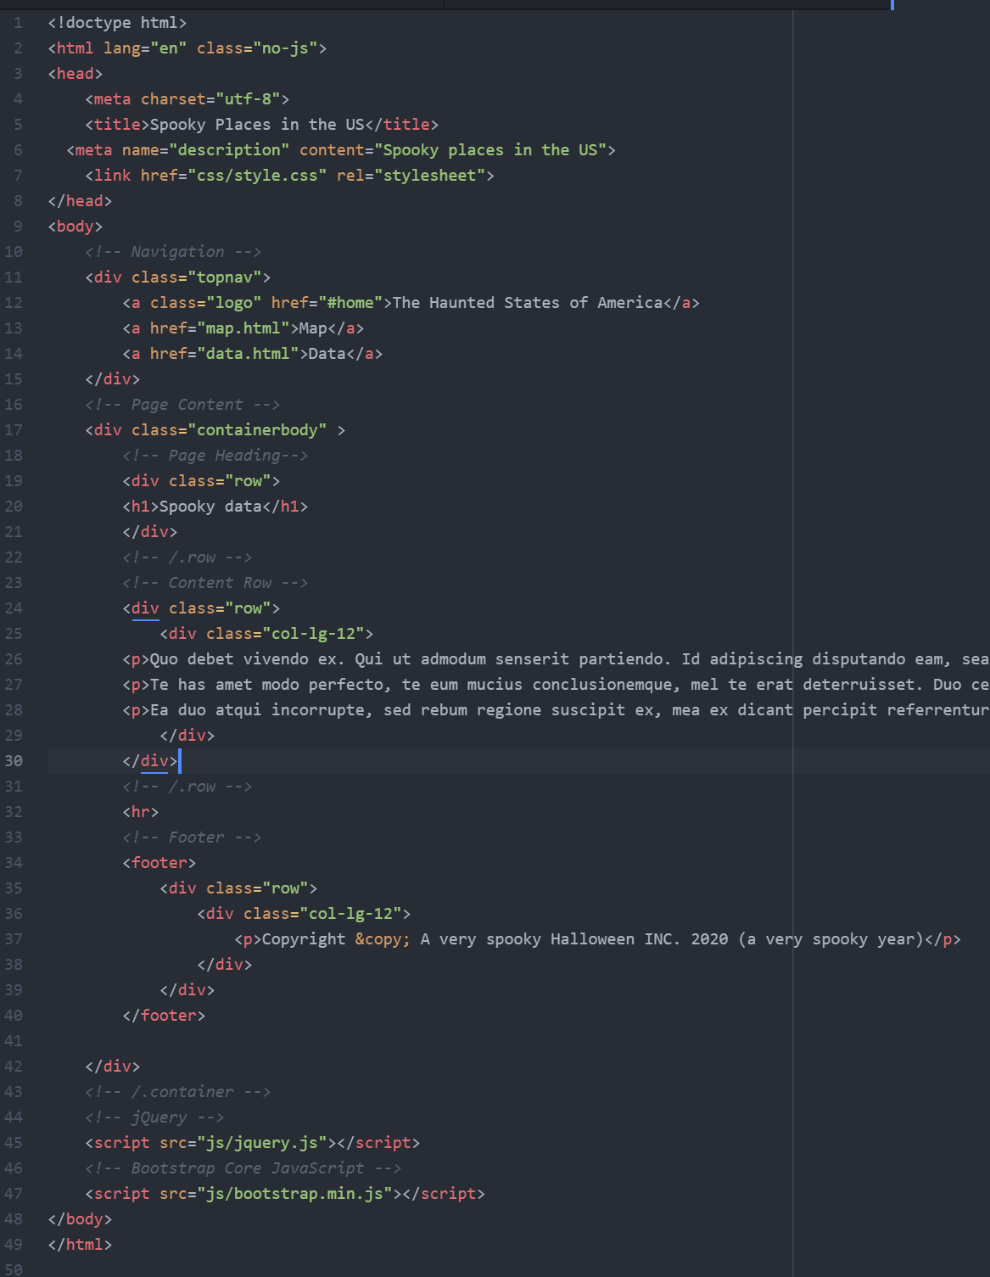
Coding > Haunted Home
HTML
Created links to Map and Data pages
Bootrstap
6

Slide 8
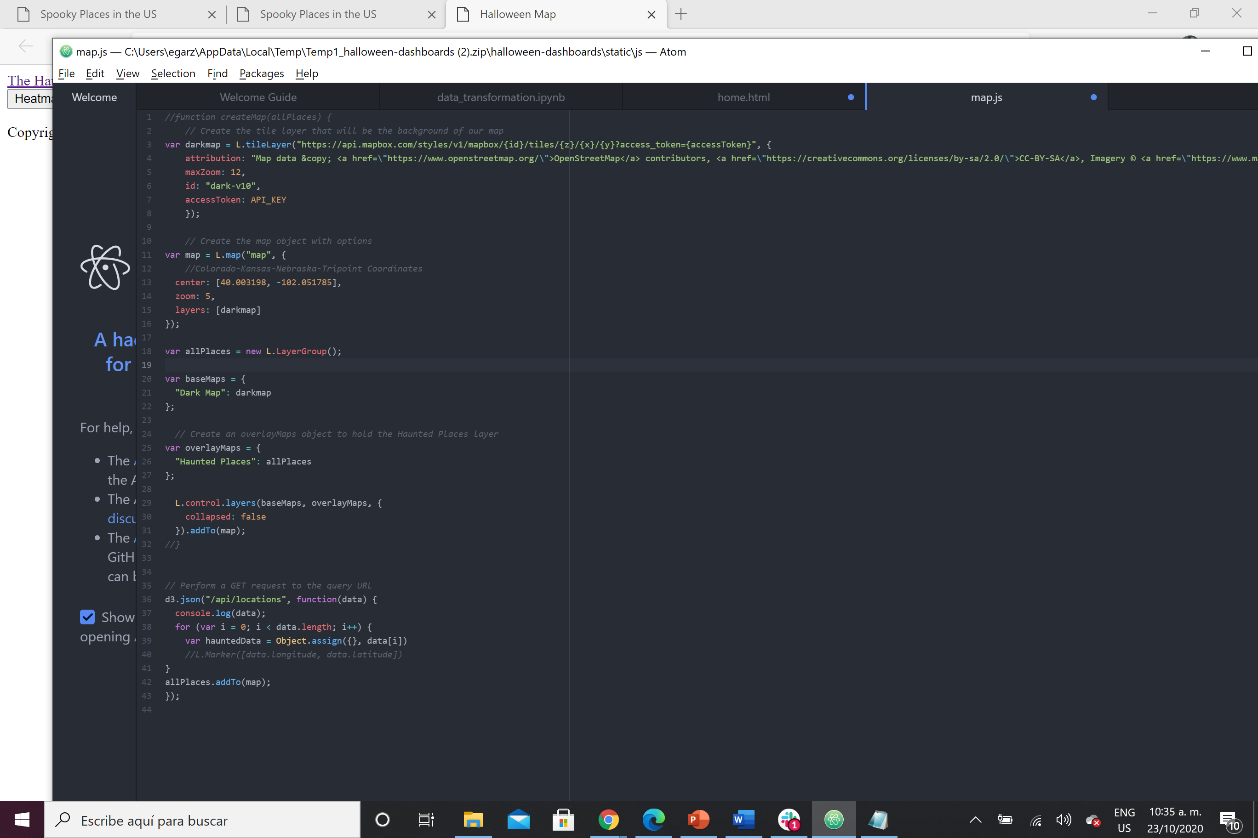
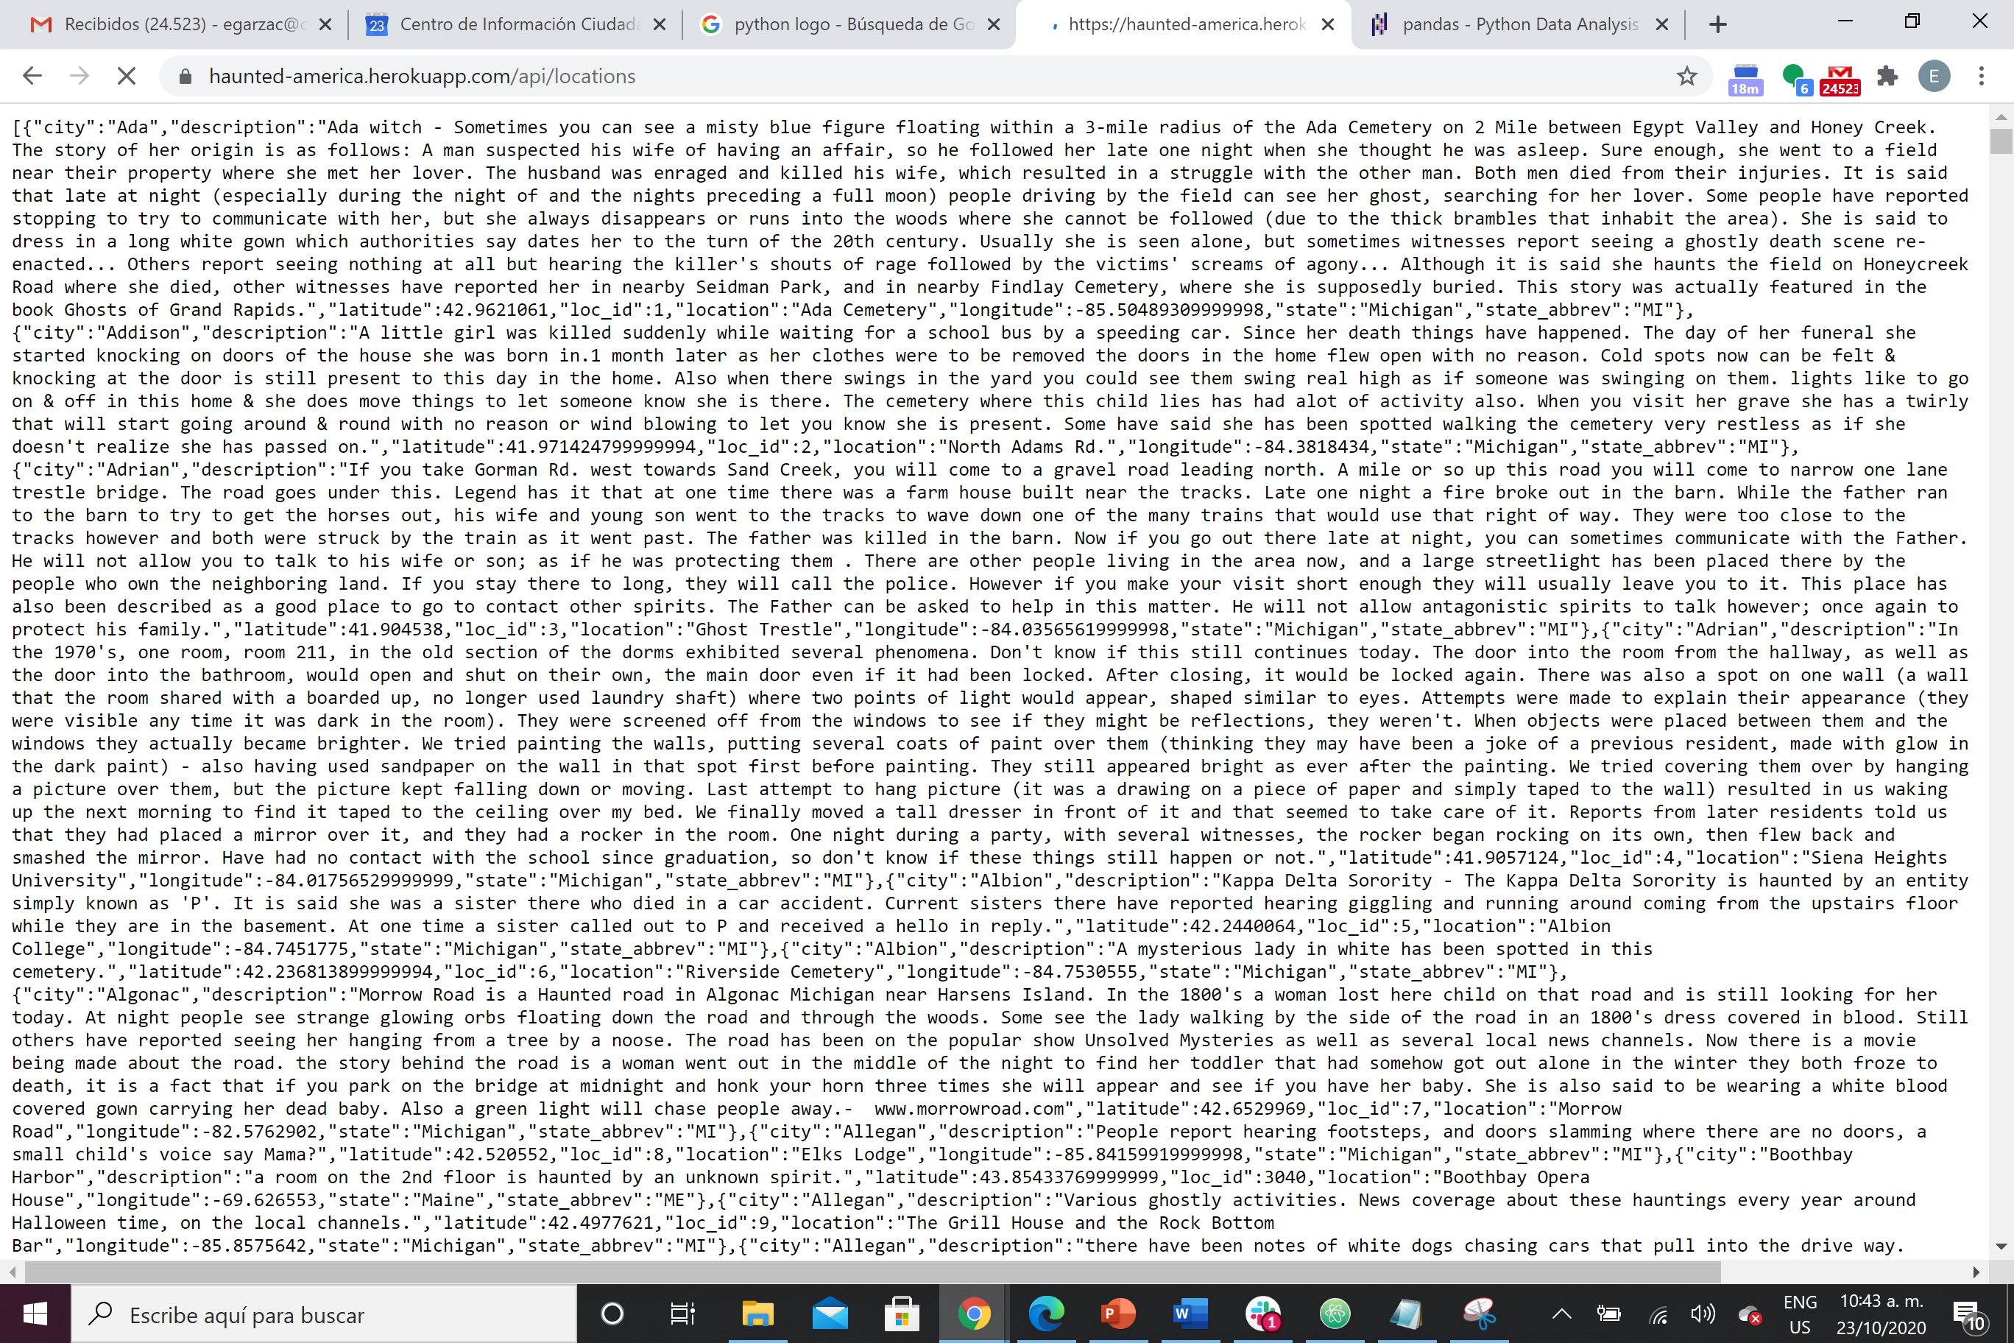
Coding > Cursed Map
Leaflet
Dark Layer
Markers from locations JSON:
https://haunted-america.herokuapp.com/api/locations
7

Slide 9
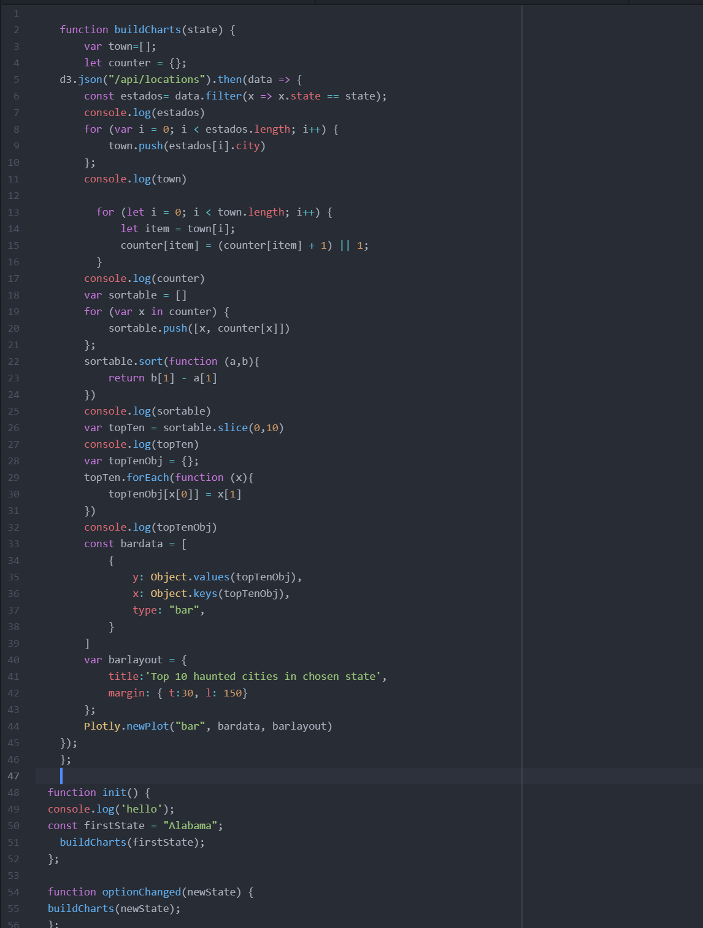
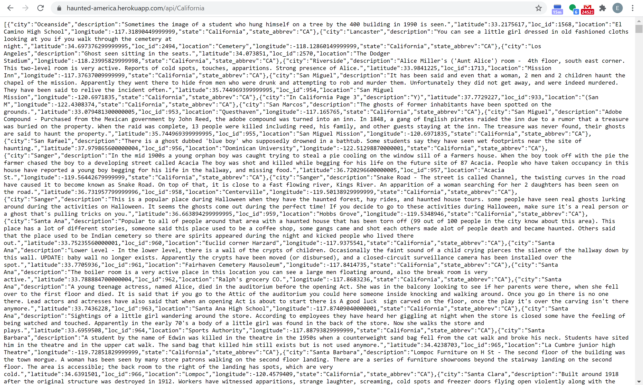
Coding > Spooky Data
Plotly -> Bars and Pie Charts
Updates based on <State > filter (dropdown in HTML)
Data from <state> JSON:
https://haunted-america.herokuapp.com/api/<state>
Example: https://haunted-america.herokuapp.com/api/California
8

Slide 10
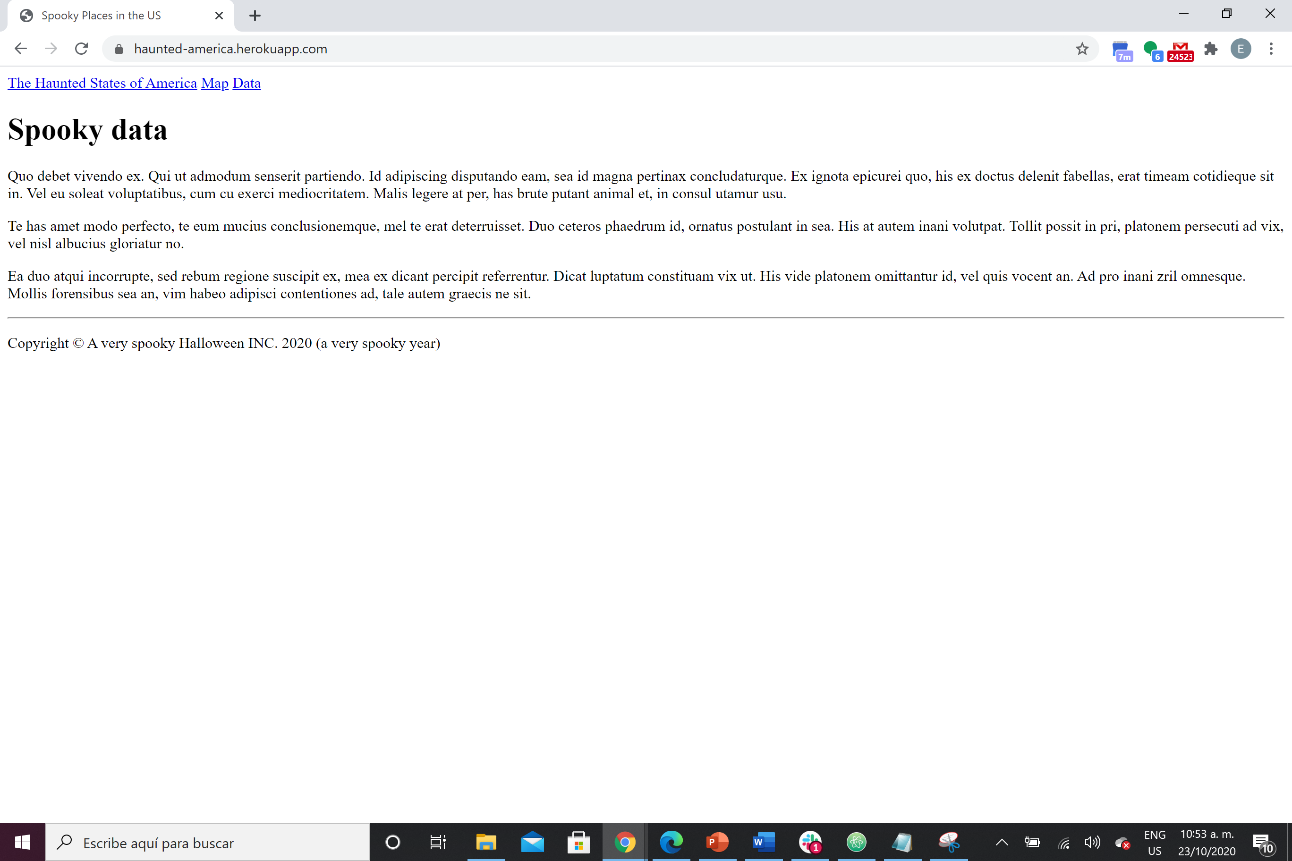
Our Website > Haunted Home
https://haunted-america.herokuapp.com/
9

Slide 11
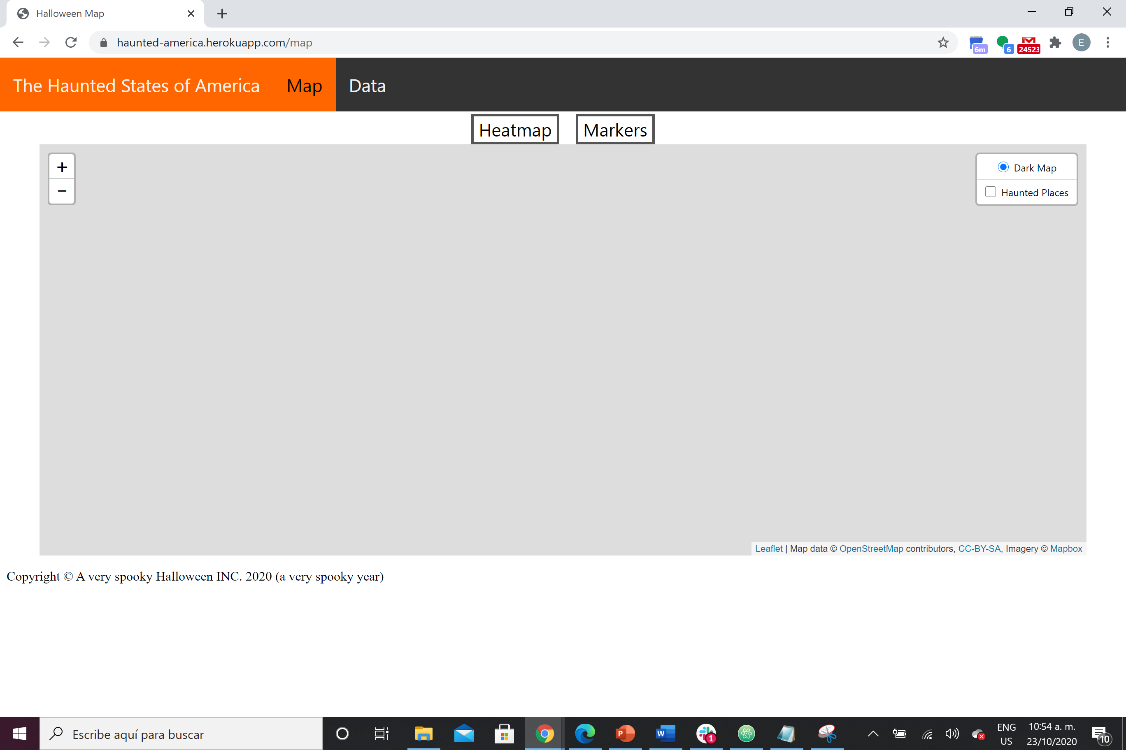
Our Website > Cursed Map
https://haunted-america.herokuapp.com/map
10

Slide 12
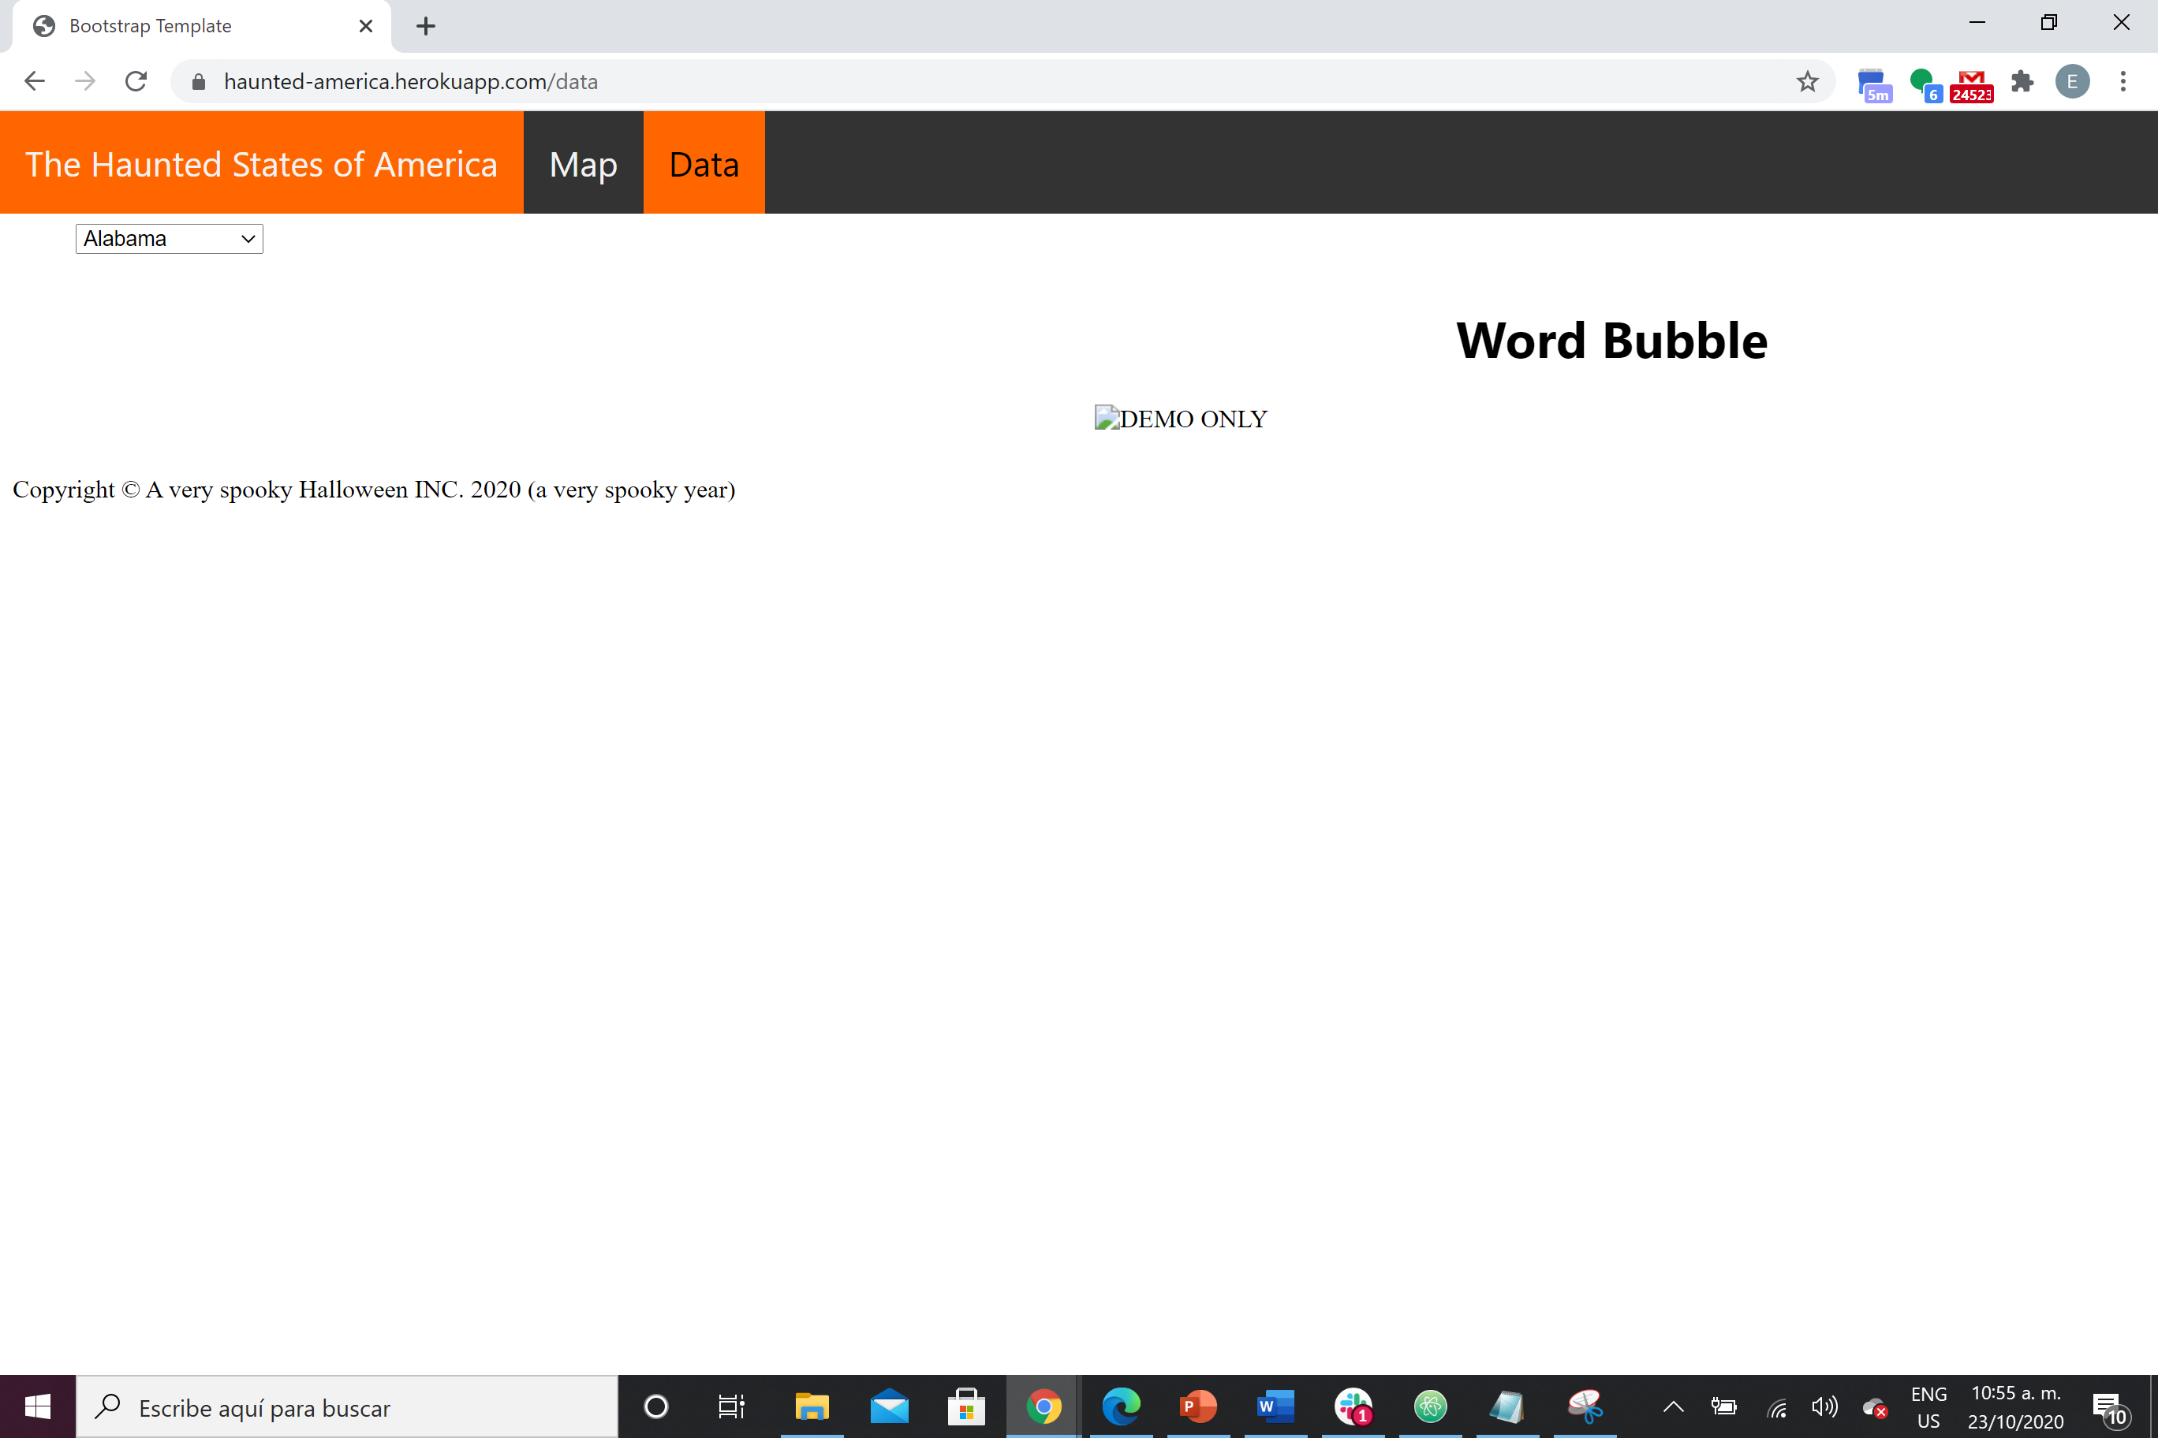
Our Website > Spooky Data
https://haunted-america.herokuapp.com/data
11

Slide 13

Thank you!
Happy Halloween

